Slide 1
Short story about Swagger, His faithful minion Swashbuckle, and a wheel horse – AutoRest.
Alexey Shcherbak,
Senior developer at DRAWBOARD

Slide 2
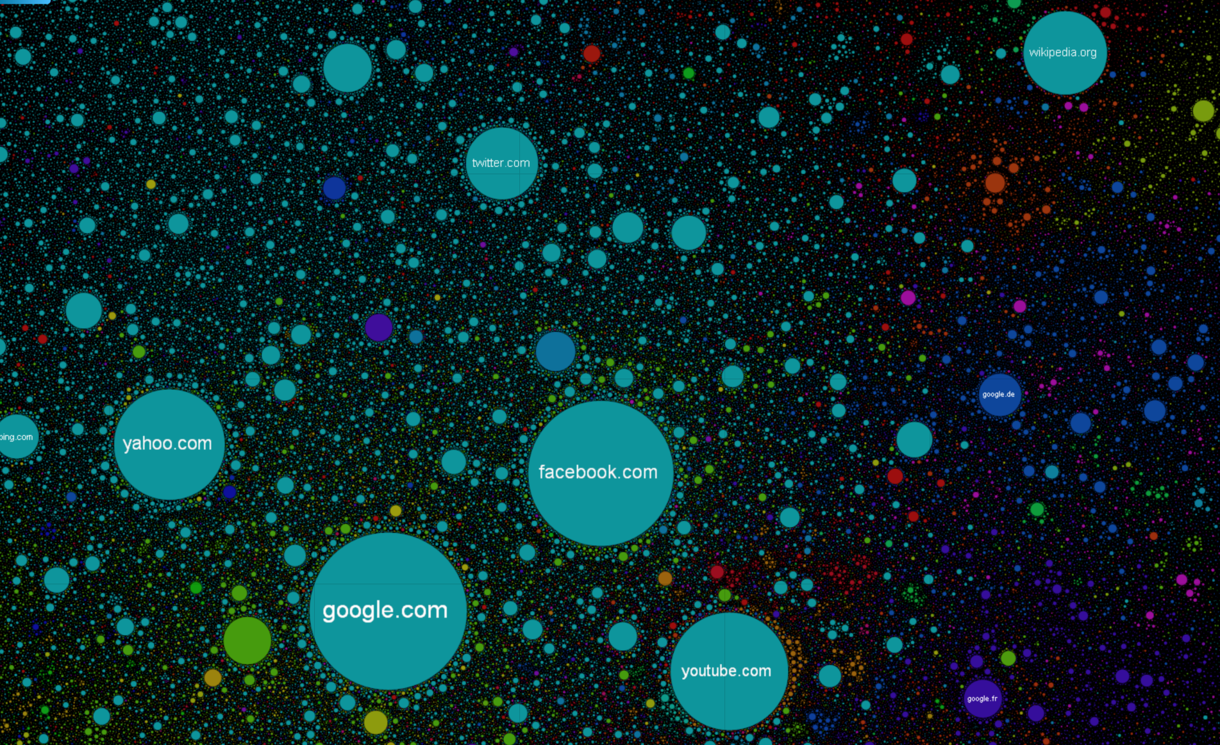
The Internet map
Dropbox.com
#98 Global rank

Slide 3
The Internet is for PO … APIs
HTTP is a Lingua franca of modern devices and websites. Everyone speaks HTTP.
JSON is your natural data format.
But how to describe API in a comprehensive way so both human and machine can understand and use it?

Slide 4

Swagger – The World's Most Popular Framework for APIs.
Uses JSON to describe your API – universal and readable format
There is a tool for your language
.NET, Go, Java, JavaScript, Node.JS, Ruby, Python and others
Biggest community on GitHub (vs competitors)
Competitors:
RAML from MuleSoft (YAML – based )
API Blueprint from Apiary( Markdown – based)

Slide 5
Swagger.json fragment
"paths": { "/pet": {
"put": { "tags": [ "pet" ],
"summary": "Update an existing pet", "description": "","operationId": "updatePet",
"consumes": [ "application/json", "application/xml" ],
"produces": [ "application/xml", "application/json" ],
"parameters": [ { "in": "body", "name": "body",
"description": "Pet object that needs to be added to the store", "required": true,
"schema": { "$ref": "#/definitions/Pet"} } ],
"responses": {
"400": { "description": "Invalid ID supplied" },
"404": { "description": "Pet not found" },
"405": { "description": "Validation exception" }

Slide 6

Swashbuckle – Swaggerize your API in 2 steps
Install-Package Swashbuckle.Core
httpConfiguration
.EnableSwagger(c => c.SingleApiVersion("v1", “Alt.NET API"))
.EnableSwaggerUi();
Just browse to http://YourWebSite/swagger

Slide 7

AutoRest – consume Swaggerized API in 42 X steps
Generates C# client for your Swagger definition
Auto-generated client is flexible and customizable
Batteries included With call retry logic.

Slide 8

Demo time

Slide 9

Gotchas
Swagger-ui.js = 1.5Mb ☺
A bit tricky to do non-standard auth and protect UI itself
Doesn’t make your API awesome automagically – you still need to carefully design it.

Slide 10
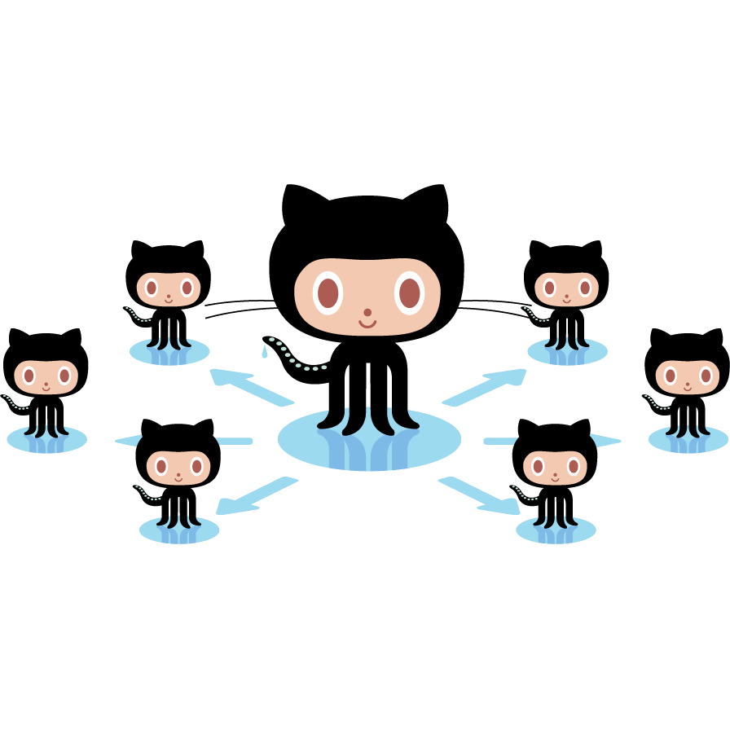
What to do next
Swaggerize your own APIs, no excuses accepted !
Ask your API providers for their Swagger.json
Generate your API Clients and keep it up-to-date with zero efforts

Slide 11

Join the API-party ☺
Azure API Apps and Azure API Management
Amazon’s API Gateway
Runscope
APIgee
Postman / Paw (REST clients)
<Your next awesome app>
And many others…

Slide 12

Any questions, you have. Yeesssssss.

Slide 13

Useful Links
Swagger http://swagger.io/
Swashbuckle https://github.com/domaindrivendev/Swashbuckle
AutoRest https://github.com/Azure/AutoRest
Demo app: https://github.com/centur/presentations/tree/master/Alt.NET-Swagger/src/SwaggerDemo
Competitors
RAML http://raml.org/
API Blueprint https://apiary.io/blueprint
Octocats https://octodex.github.com/
Internet Map http://internet-map.net/
We are hiring : https://careers.stackoverflow.com/company/drawboard

